Slide 1
Studies of Quantum Dots using Neural Networks and Coupled Cluster

Slide 2
Overview
System we want to solve:
Quantum Dots - Trapped electrons
Methods we will use to solve it:
Hartree-Fock – Simple solution, useful starting point
Coupled Cluster – Builds on Hartree-Fock, fast and accurate
Variational Monte Carlo – Can optimize any function towards being a good solution: In our case a combination of Hartree-Fock and a Neural Network

Slide 3
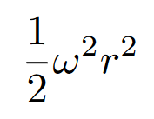
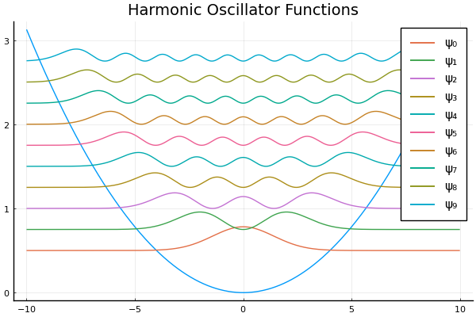
Quantum Dots
Electrons trapped in a Harmonic Potential - The potential pulls them in - The electrons repel each other
Good approximation to other potentials
Non-interacting case has an exact analytical solution

Slide 4

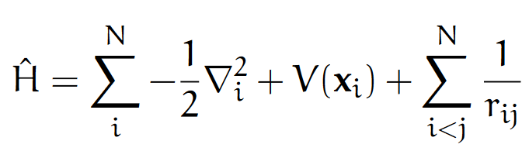
The Equation we want to solve
The time-independent electronic Schrödinger equation
The variational method - Trial wave function - Optimization

Slide 5
Goals
Implement a variational Monte Carlo code combining the Hartree-Fock solution with a neural network
Implement the Hartree-Fock and Coupled Cluster methods
Make the code really fast

Slide 6
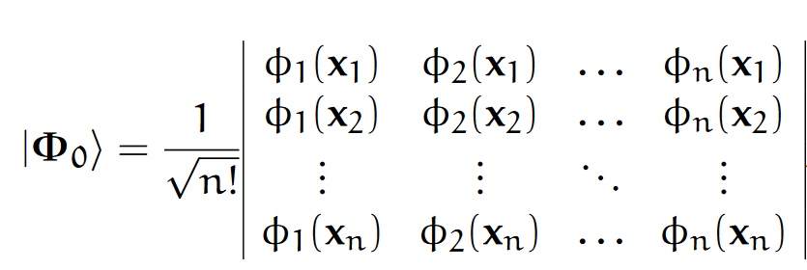
The Hartree-Fock Method
A single Slater determinant
Combinations of Harmonic Oscillator basis functions
Optimize using an iterative scheme

Slide 7
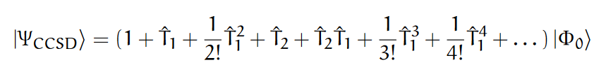




Coupled Cluster
Linear combination of many Slater determinants
Written in terms of combinations of just a few operators
We solve an equation close to the Schrödinger equation
Often gives a very good estimate for the ground state energy

Slide 8
Variational Monte Carlo

Slide 9
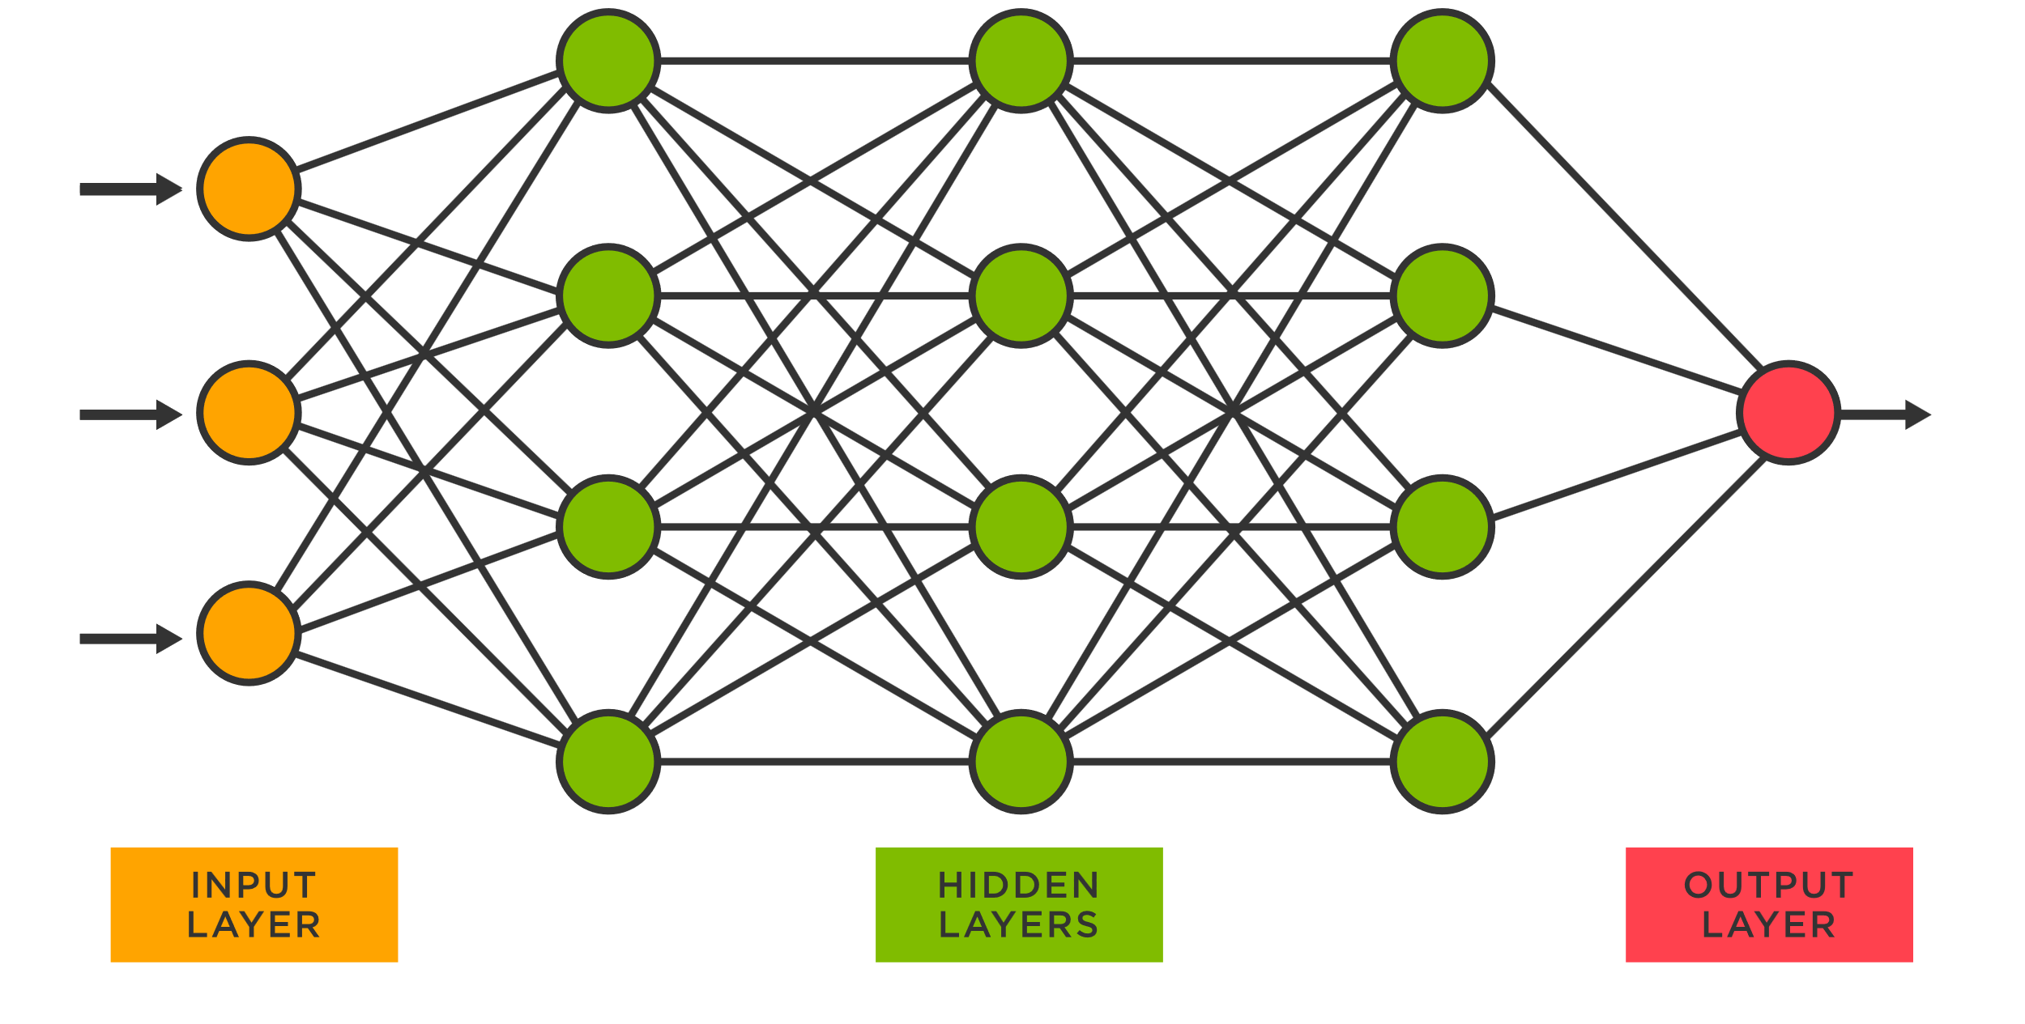
Neural Networks
Very flexible function - The universal approximation theorem: «Can approximate any function»
Must be optimized
Has shown great results in many fields

Slide 10
Our trial wave function

Slide 11
Similar approaches by others

Slide 12
Our Implementation

Slide 13
Working in Julia

Slide 14
Optimizations

Slide 15
Automatic differantiation

Slide 16
Ground state energies

Slide 17
One-body density

Slide 18
Performance

Slide 19
Limitations and future work

Slide 20
Conclusion

